Slide 1
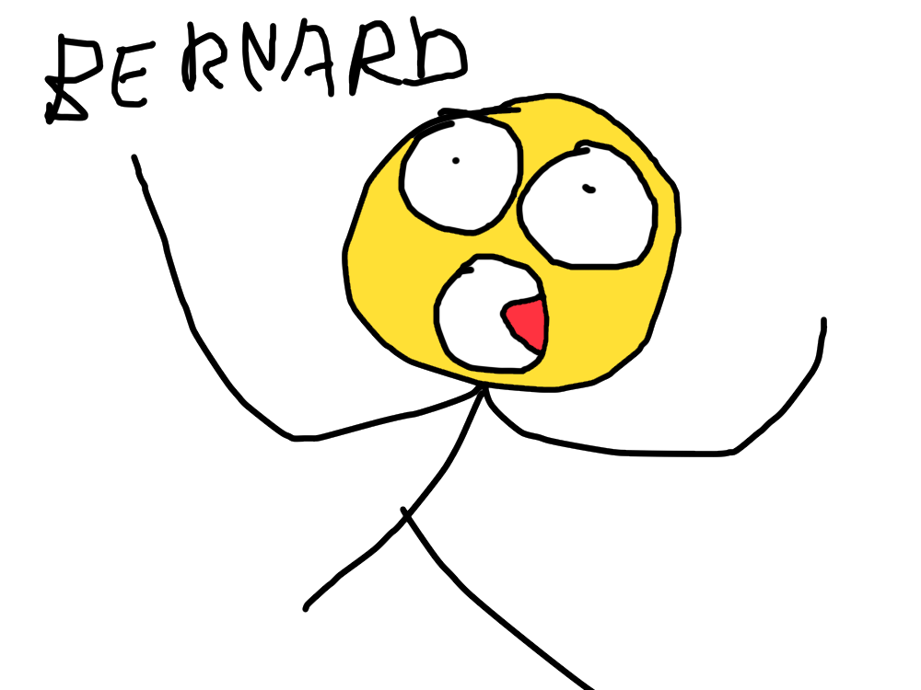
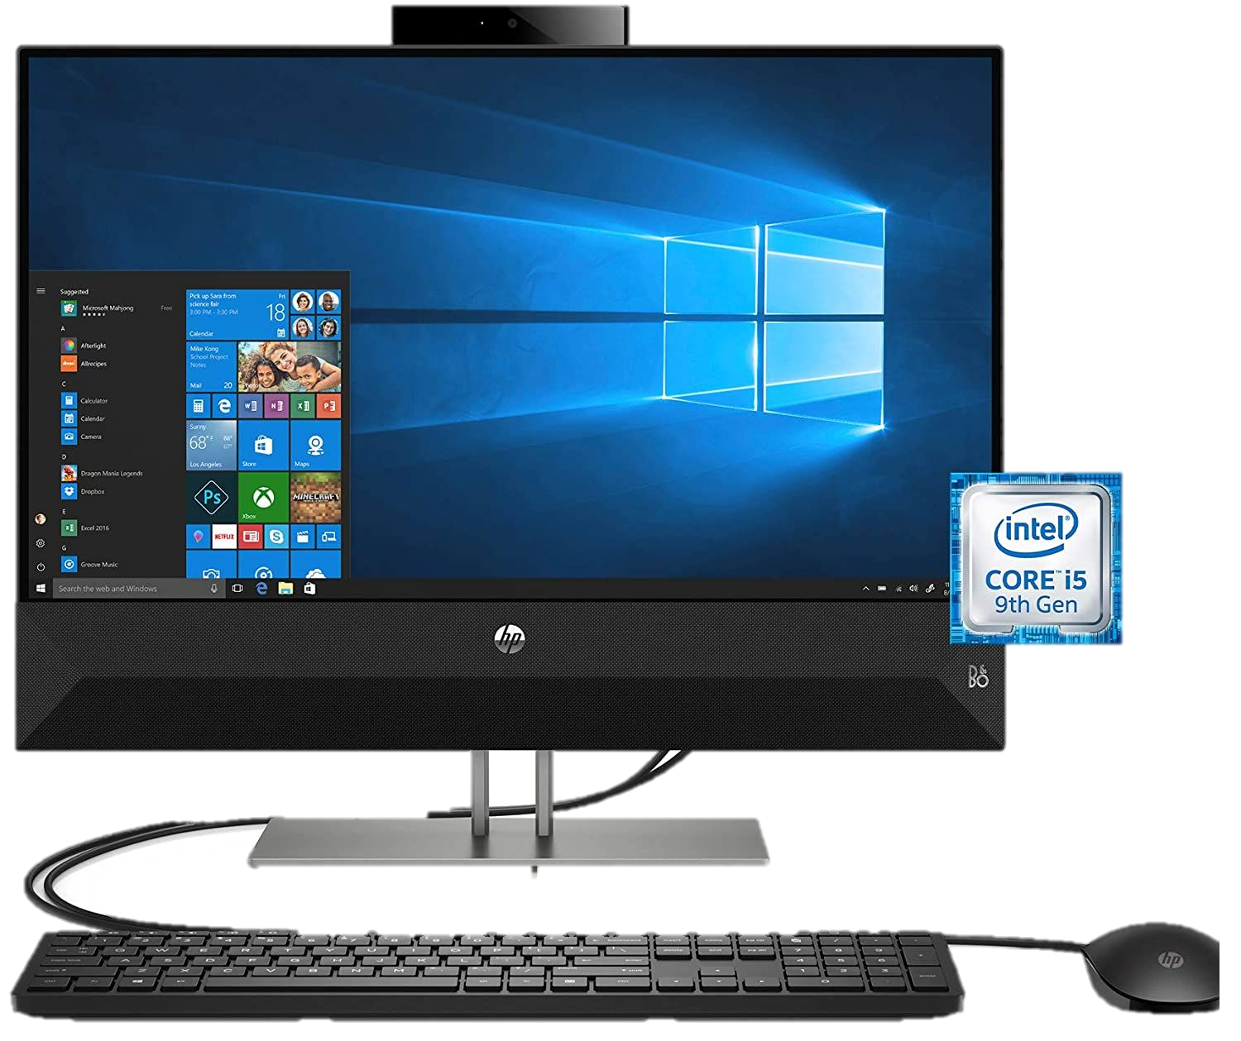

WELCOME TO MY PRESENTATION!
HELLO!!!

Slide 2
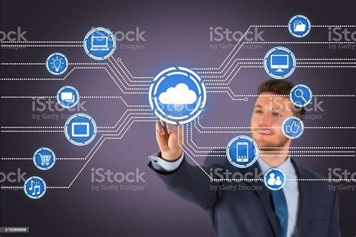

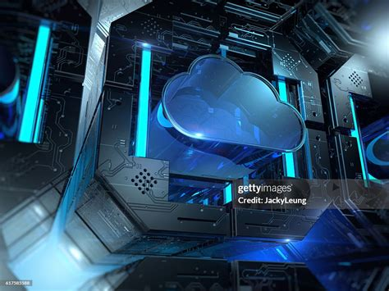
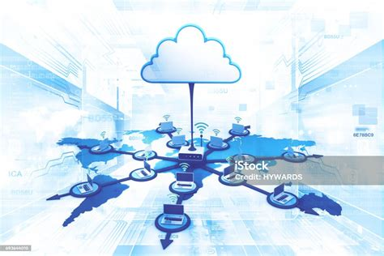
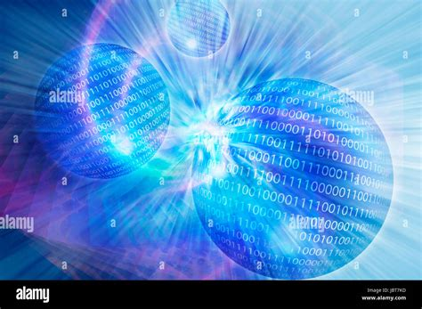
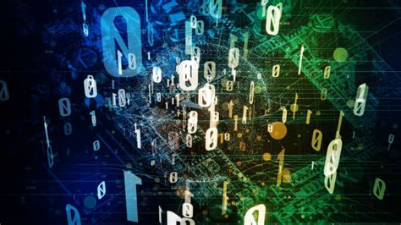
Well I don’t know
FIRST UP: WHAT IS THE INTERNET OF THINGS?

Slide 3
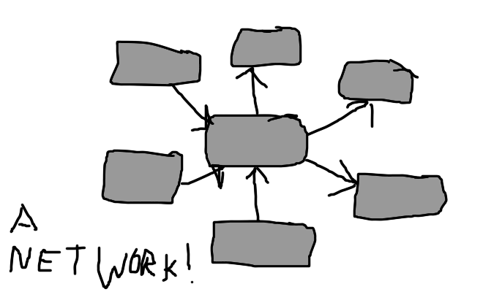
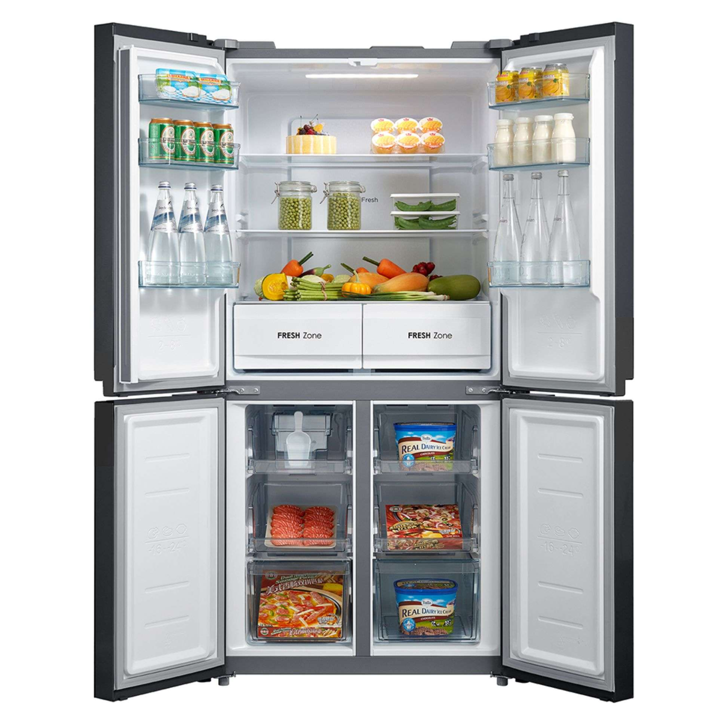
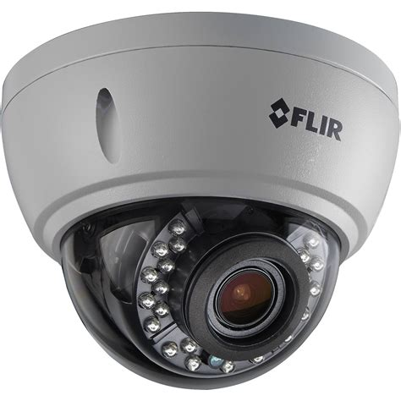

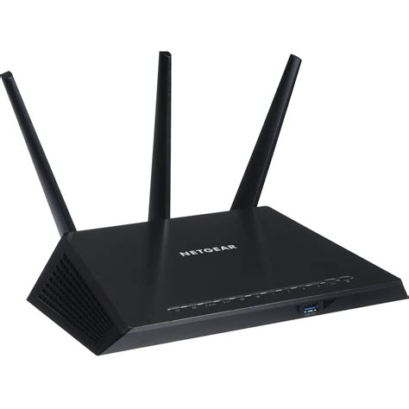
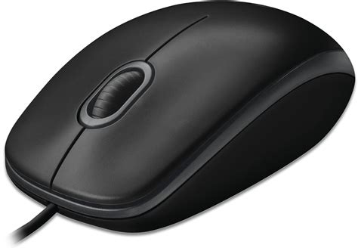
The Internet of Things refers to a network of physical devices, vehicles, appliances, and other physical objects that are embedded with sensors, software, and network connectivity, allowing them to collect and share data.
[1] IBM

Slide 4
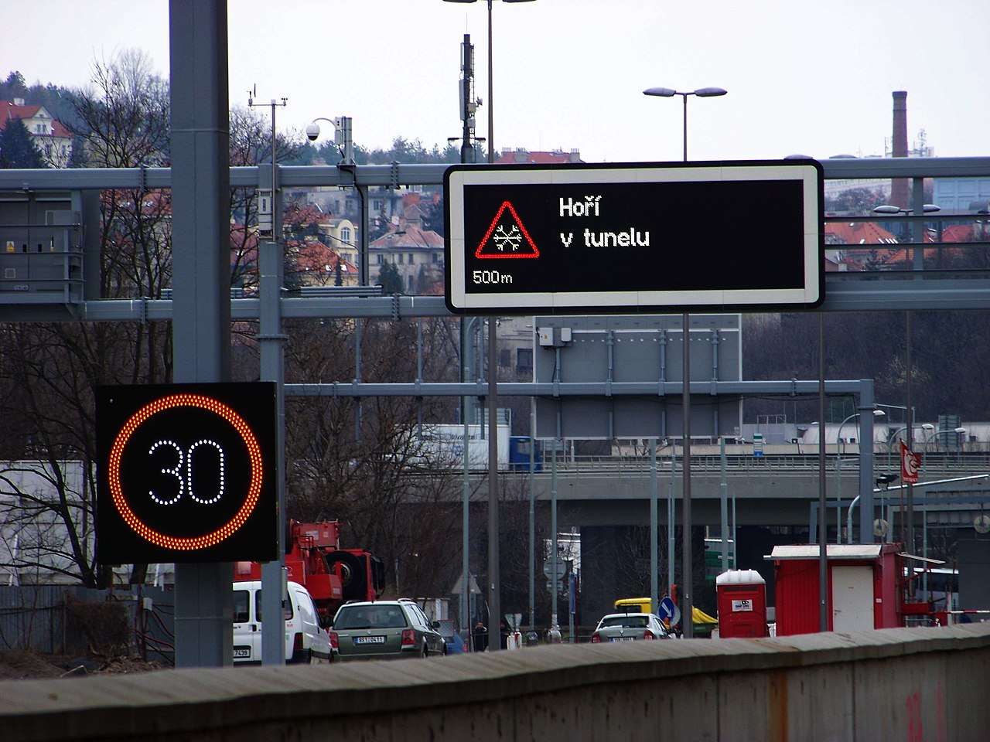
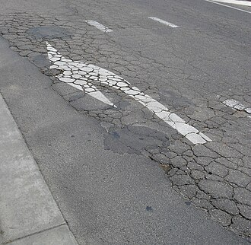
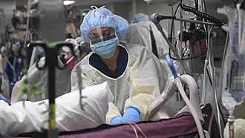
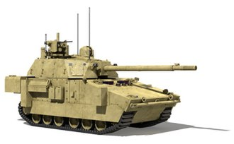
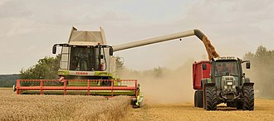
Ok, cool
BUT WHY DO WE CARE?
PREDICTIVE MAINTENANCE-> MORE EFFICIENT INFRASTRUCTURE
Prague-Libeň, Czech Republic. Nová Povltavská street, road information displays in testing.
ŠJů, Wikimedia Commons CC BY-SA 3.0
SMART TRAFFIC CONTROL -> MORE EFFICIENT TRANSPORT
REMOTE HEALTH MONITORING -> MORE EFFICIENT HEALTHCARE
ENVIROMENTAL DATA AND CROP MONITORING -> MORE EFFICIENT AGRICULTURE
CONNECTED MILITARY SENSORS -> MORE EFFICIENT DESTRUCTION

Slide 5
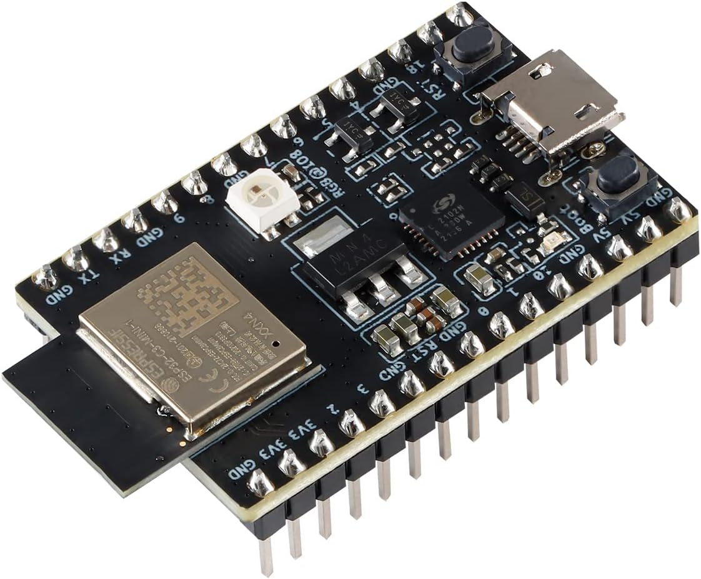
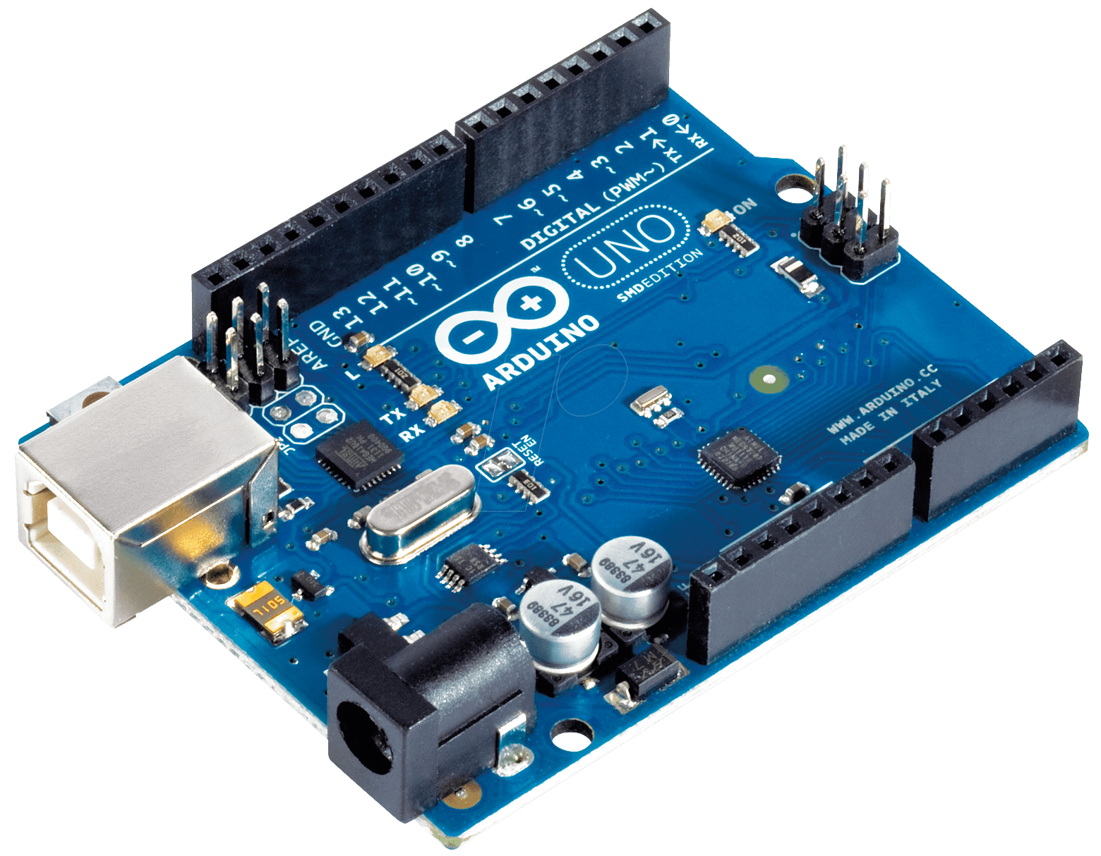
EMBEDDED DEVICES
ESP32
ARDUINO
CONTROLS EVERYTING BASICALLY

Slide 6
THE OSI MODEL
OSI model
Layer |  |  | Protocol data unit (PDU) | Function^{[26]}
Host layers | 7 | Application | Data | High-level protocols such as for resource sharing or remote file access, e.g. HTTP.
 | 6 | Presentation |  | Translation of data between a networking service and an application; including character encoding, data compression and encryption/decryption
 | 5 | Session |  | Managing communication sessions, i.e., continuous exchange of information in the form of multiple back-and-forth transmissions between two nodes
 | 4 | Transport | Segment, Datagram | Reliable transmission of data segments between points on a network, including segmentation, acknowledgement and multiplexing
Media layers | 3 | Network | Packet | Structuring and managing a multi-node network, including addressing, routing and traffic control
 | 2 | Data link | Frame | Transmission of data frames between two nodes connected by a physical layer
 | 1 | Physical | Bit, Symbol | Transmission and reception of raw bit streams over a physical medium

Slide 7
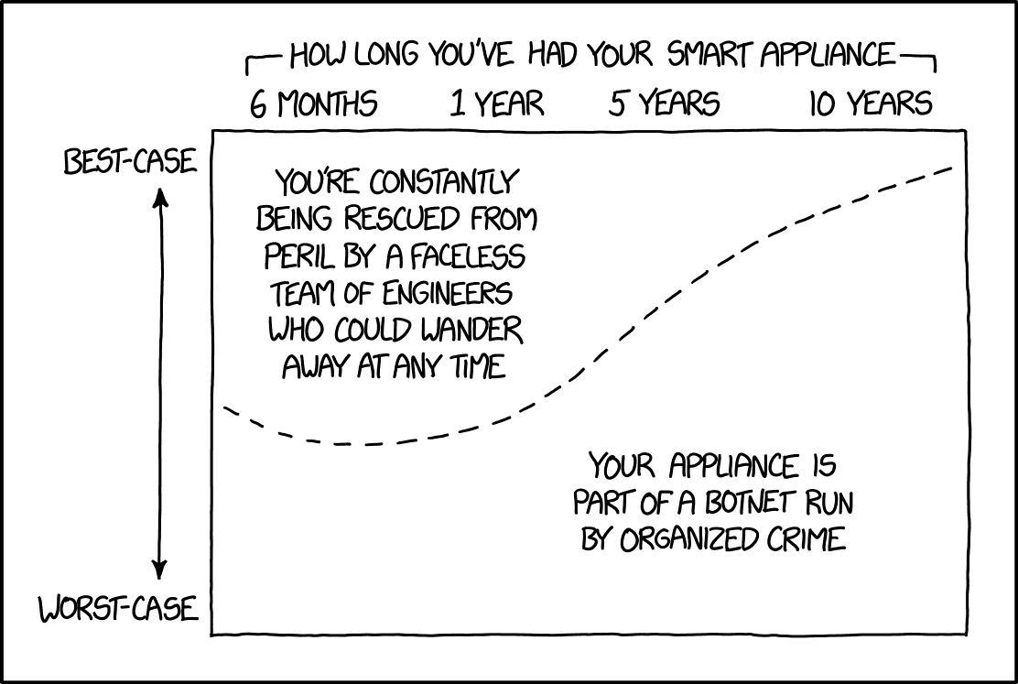
SHORTCOMINGS : SECURITY
2016: MIRAI BOTNET INFECTS 200,000-300,000 DEVICES
USED FOR DDoS ATTACKS
[2] WIKIPEDIA
If they're getting valuable enough stuff from you, at least the organized crime folks have an incentive to issue regular updates to keep the appliance working after the manufacturer discontinues support. [3] XKCD

Slide 8
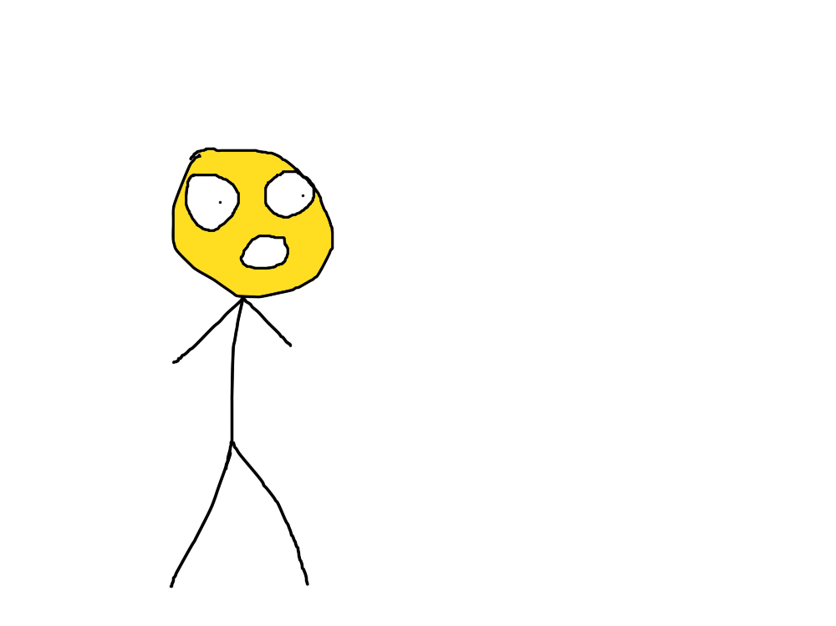
SHORTCOMINGS : SECURITY: PART 2
By 2008 security researchers had shown the ability to remotely control pacemakers without authority.
[2] Wikipedia
What a nice day, I sure hope I don’t get hacked
Internet connected pacemaker

Slide 9
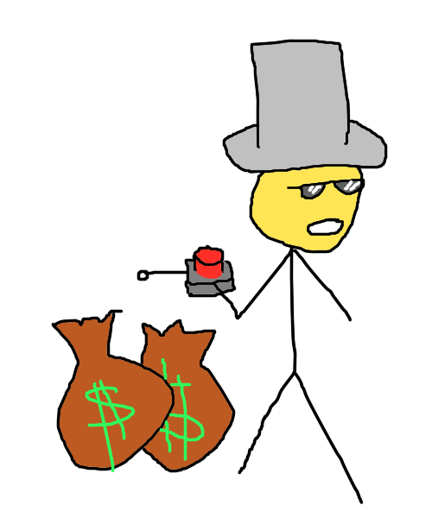
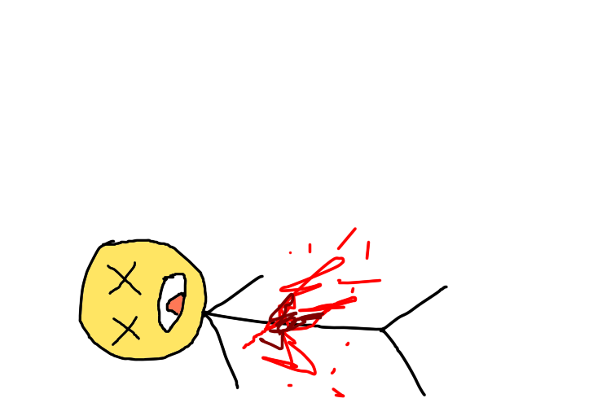
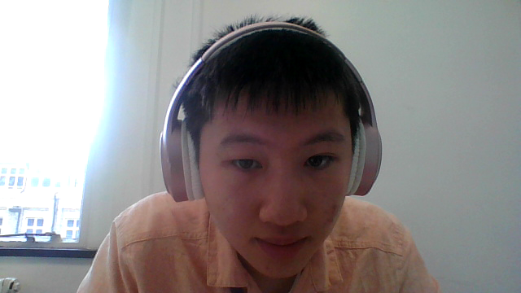
SHORTCOMINGS: RELIANCE ON CONTINUAL SUPPORT
Its just business kiddo

Slide 10
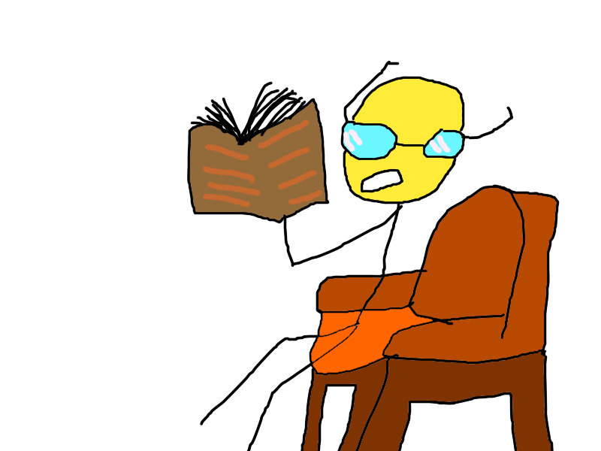
CITATIONS
[1] https://www.ibm.com/topics/internet-of-things
[2] https://en.wikipedia.org/wiki/Internet_of_things#cite_ref-276
[3] https://xkcd.com/1966/

Slide 11
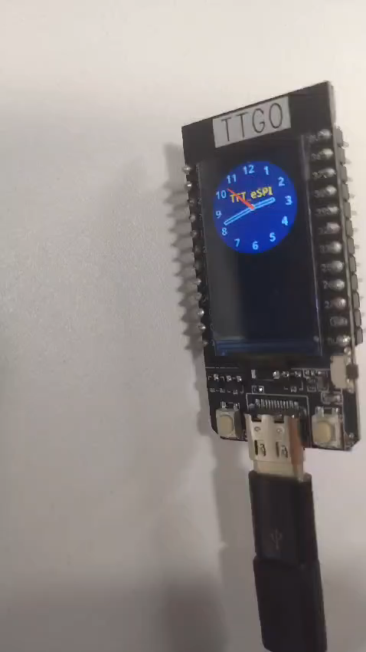
Making the microcontroller work
Sorry no more pictures here, its night before the deadline and I need this done now
As you can see, the program is working

Slide 12
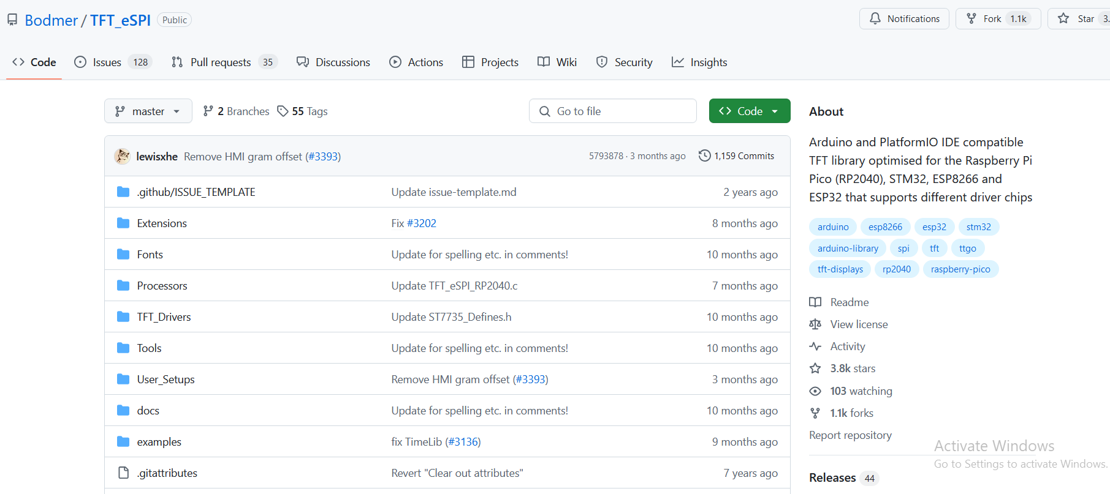
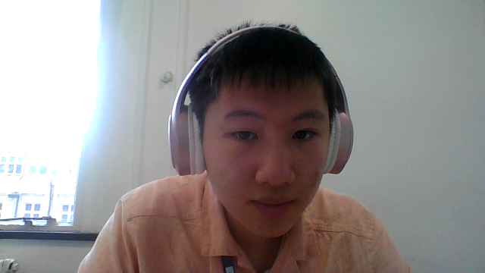
Got the clock app from TFT_eSPI example code

Slide 13
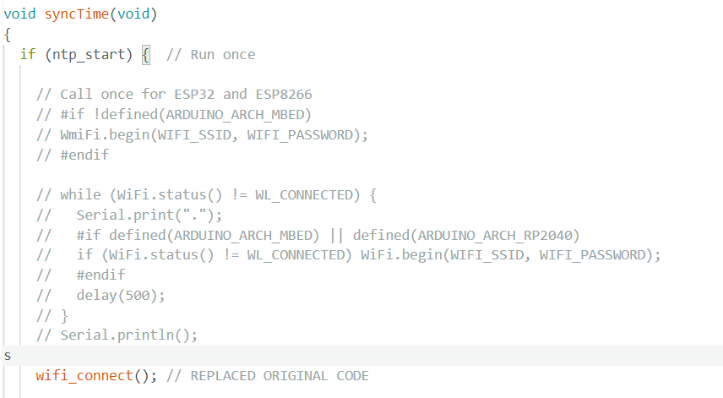
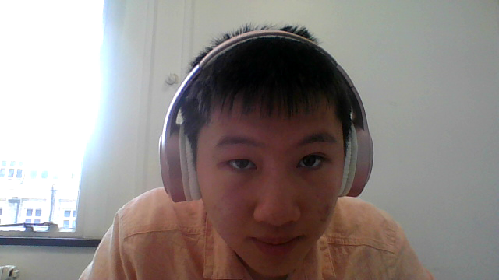
Modifying the code to run
Inserted code provided from the Moodle page in there

